Slide 1
Driver’s Education
Written Exam Preparation
Part I

Slide 2
Introduction & Welcome
Welcome to iDrivio’s Online Written Exam Preparation Course part 1! This presentation will prepare you to take the Written Exam administered by the Illinois Secretary of State when you apply for an instruction permit or renew your driver’s license.
To navigate through the presentation, click the forward and back arrows on the screen.

Slide 3
Avoiding Distracted Driving: No Hand-Held Phones
Illinois law prohibits the use of hand-held cellphones while driving. Hands-free and Bluetooth technology are allowed for drivers age 19 and older.
Drivers under age 19 are prohibited from any cellphone usage, including hands-free devices.

Slide 4
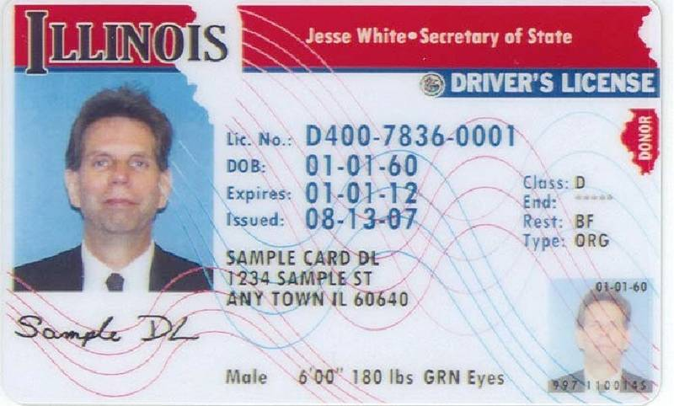
Weight Limit for Class D License: 16,000 lbs.
Driver’s licenses are classified by the gross vehicle weight rating (GVWR) of your vehicle. Drivers seeking a basic license to operate a car in Illinois are issued a Class D license.
Class D — Any motor vehicle with a GVWR of 16,000 pounds or less (such as a car, pickup truck, SUV, or van).

Slide 5
License Classifications
The classifications for large vehicles (and motorcycles, by engine size) are below:
Class A & B: 26,001 lbs. or more (CDL)
Class C: 16,000 lbs. or more but less than 26,001 lbs.
Class D: 16,000 lbs. or less
Class L: Motor-driven cycle with less than 150cc engine
Class M: Motorcycle or motor-driven cycle

Slide 6
Buckle Up: Every Trip, Every Time
Illinois law requires all drivers and passengers (front and back seat) age 8 and older to wear safety belts even if the vehicle is equipped with air bags. Passengers under age 8 must be secured in an appropriate child restraint system as covered by the Child Passenger Protection Act.

Slide 7
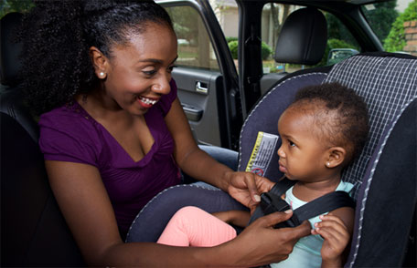
Buckle Up: Every Trip, Every Time
When riding in a truck with only a front seat equipped with safety belts, a child under age 8 must be secured in an appropriate child restraint system. Note: Seat belt use/child restraint use is required in all seating positions in a vehicle.

Slide 8
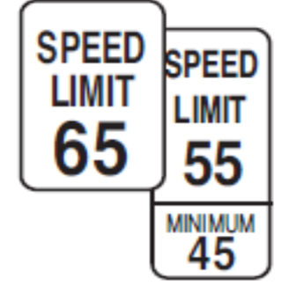
Speed Limits in Illinois
Speeding is one of the leading contributors to vehicle crashes. You may drive at the maximum allowable speed only under safe conditions. For safety purposes, a minimum speed limit may be posted along certain roadways.
When minimum limits are not posted, drivers should not drive so slow as to create an interference with the normal movement of traffic.

Slide 9
Speed Limits in Illinois
The following speed limits apply, unless otherwise posted:
• Interstates, tollways, freeways and some four-lane highways — 70 mph
• Highways with four lanes — 65 mph
• Other highways and rural areas — 55 mph
• City/Town Areas — 30 mph
• Alleys — 15 mph
• School Zones — 20 mph (on school days between 7 a.m. and 4 p.m. when children are present and signs are posted).

Slide 10
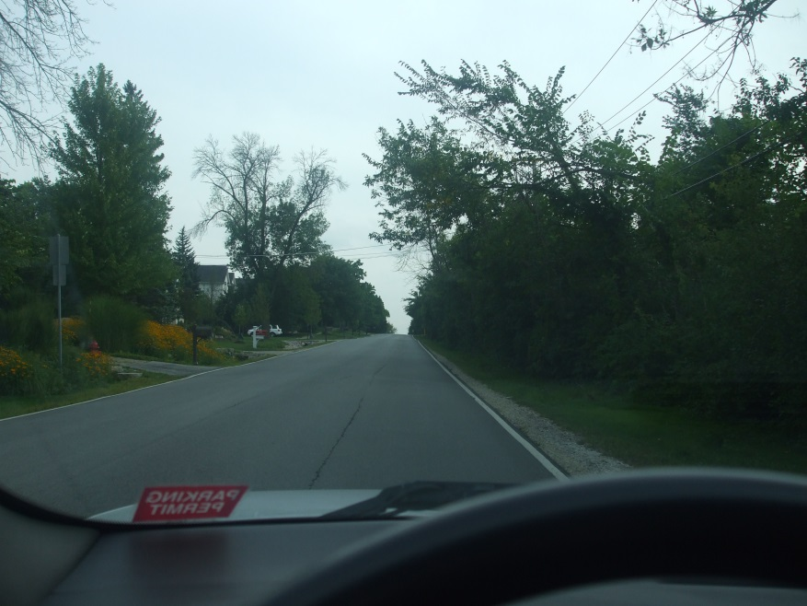
Additional Areas for Reduced Speeds
Drivers should reduce speed near intersections and on hills, curves, shaded areas (due to possible ice in winter), and narrow roads in order to be safe.
The presence of pedestrians, traffic, weather, mechanical problems or road conditions can add to the level of risk on the road.
Limited visibility on hills requires drivers to travel at lower speeds.

Slide 11
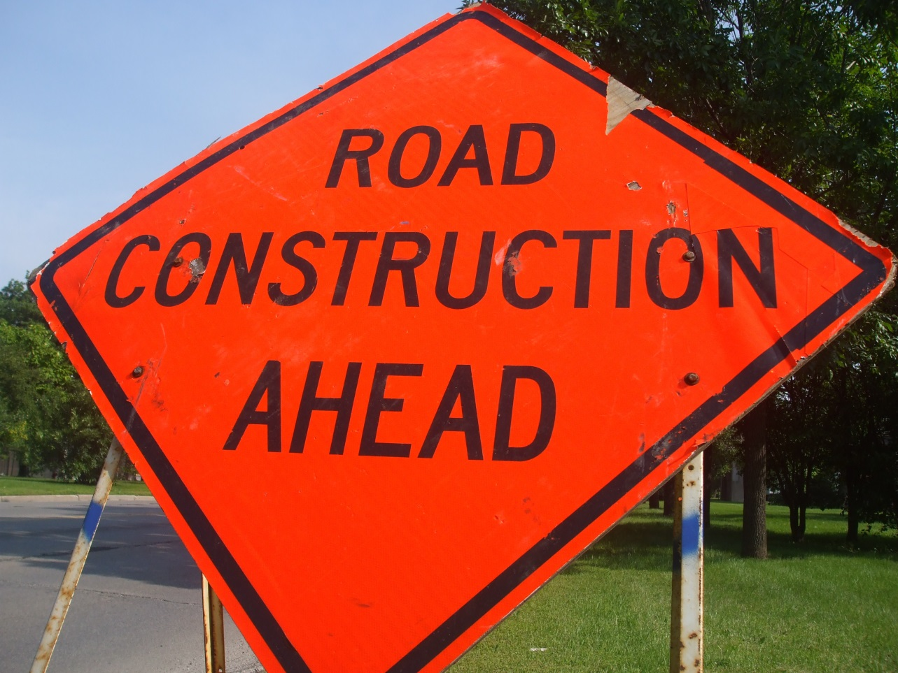
Construction/Maintenance Zone Safety
The following slides provide an overview of what to do to stay safe—and avoid traffic citations— when driving in work zones.

Slide 12
Construction/Maintenance Zone Safety
When approaching or entering a highway construction or maintenance area (also known as a work zone), Illinois law requires motorists to slow down, discontinue wireless/cellphone use (unless using a hands-free device that may include the use of a single-sided headset), yield to any authorized vehicles or workers in the area, change to a lane away from the workers when possible, and proceed with caution.

Slide 13
Driving Near Vehicles with Flashing Lights
Motorists have to follow a series of steps to ensure their safety—and workers’ safety—when driving near a vehicle displaying rotating, oscillating, or flashing lights.

Slide 14
Driving Near Vehicles with Flashing Lights
When approaching a stationary emergency/maintenance vehicle using visual signals (such as flashing lights), Illinois law requires motorists to yield, change to a lane away from the emergency workers when possible to leave a “buffer zone” between their car and the workers, and proceed with caution. This is sometimes called the “move over” law. If a lane change is not possible, reduce speed and proceed with caution.

Slide 15
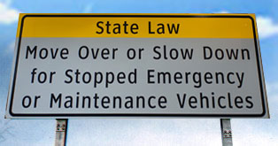
Driving Near Vehicles with Flashing Lights
The “move over” law is designed to ensure the safety of everyone who is working or driving near an emergency or maintenance vehicle.

Slide 16
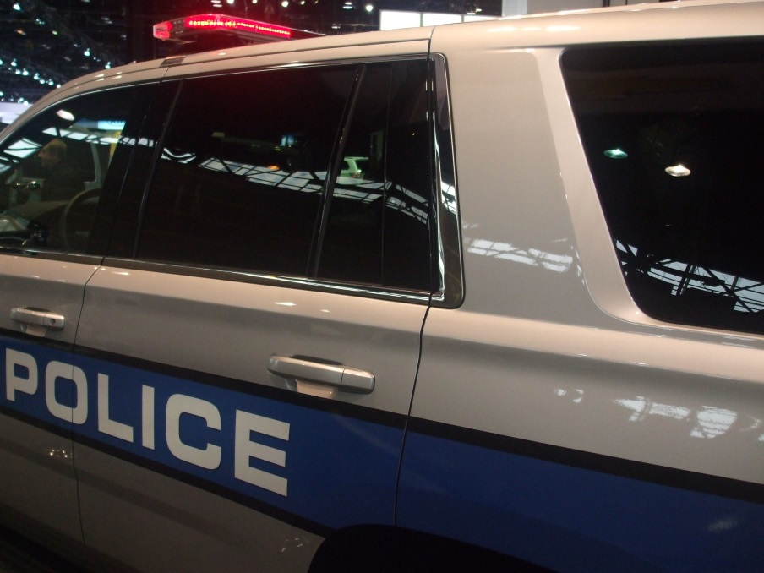
Driving Near Vehicles with Flashing Lights
Drivers in Illinois are required to leave a “buffer zone” between their car and any vehicle on the shoulder that is displaying flashing lights. This includes cars on the shoulder displaying hazard flashers as well as other vehicles with flashing lights, including tow trucks, police and fire vehicles, motorist assistance vehicles, and highway maintenance vehicles.

Slide 17
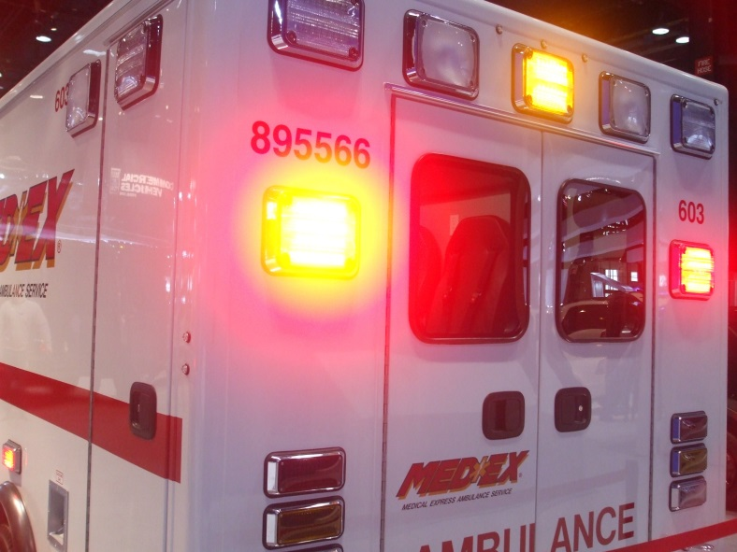
Emergency Vehicles: Pull to the Right for Sirens and Lights
When being approached by an emergency vehicle using audible and visual signals (lights and/or sirens), Illinois law requires motorists to immediately pull to the right side of the road and allow the emergency vehicle to pass.

Slide 18
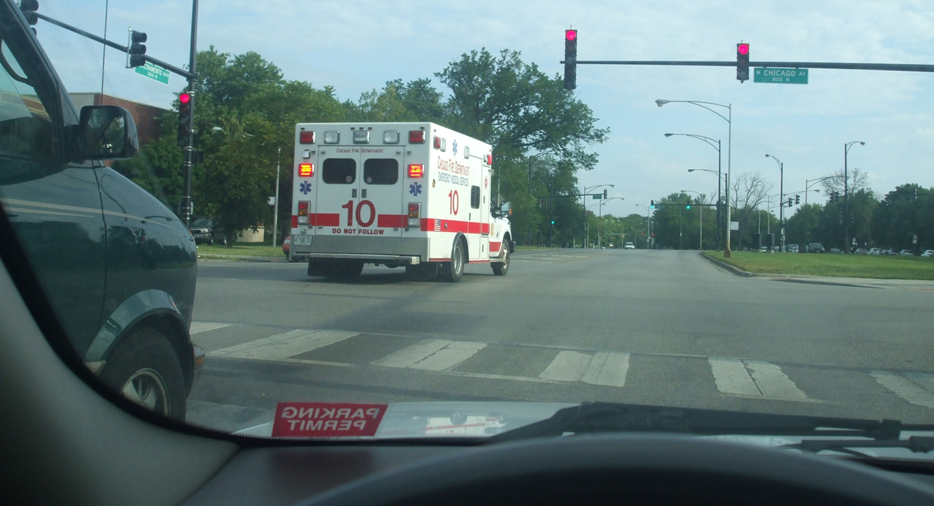
Emergency Vehicles: Pull to the Right for Sirens and Lights
In some cases a complete stop may be necessary to allow the emergency vehicle to pass. If stopped at an intersection with two-way traffic, remain stopped until the emergency vehicle passes.

Slide 19
School Zone Safety
When approaching a marked school zone (typical school hours are 7 a.m.-4 p.m.) on days when school is in operation and children are present [e.g., visible outdoors, near school grounds], a driver must:
Discontinue wireless/cell phone use (unless using a hands-free device that may include the use of a single-sided headset),
Reduce speed to 20 mph, and
Stop and yield the right-of-way to any children or adults in the crosswalk area.

Slide 20
Funeral Procession Safety
Motorists encountering a funeral procession must yield the right-of-way to all vehicles in the procession.
Motorists must NOT drive between vehicles in an organized funeral procession, except when required to do so by a law enforcement officer; must NOT join a funeral procession for the purpose of securing the right-of-way; or attempt to pass any vehicle in an organized funeral procession, except where a passing lane has been specifically provided.

Slide 21
Right-of-Way: An Overview
Right-of-way laws help keep order on the roads. A driver must yield the right-of-way to other drivers or pedestrians:
When making a right turn on a red light after a complete stop.
After coming to a complete stop at an intersection where there is a stop sign or flashing red signal. If there is no stop line, stop before the crosswalk. If there is no crosswalk or stop line, stop at a place where all approaching traffic can be seen.

Slide 22
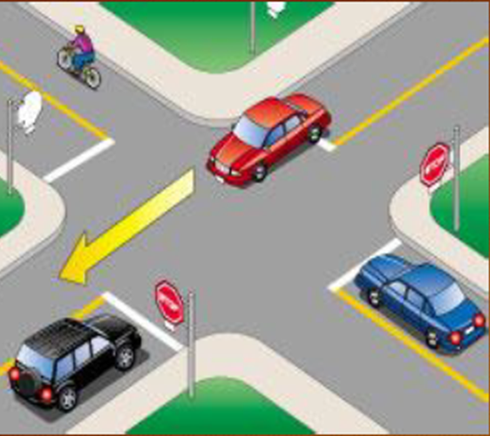
Right-of-Way: Who Goes First?
Who gets to go first when multiple cars are present at an intersection?
When more than one driver reaches a four-way stop intersection, the first driver to stop should be the first to go.
When two vehicles on different roadways arrive at a four-way stop intersection at the same time, the vehicle on the left should yield to the vehicle on the right.

Slide 23
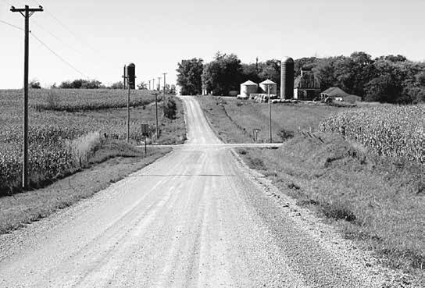
Right-of-Way: Who Goes First?
When two vehicles on different roadways reach an uncontrolled intersection (no traffic signs) at the same time, the vehicle on the left should yield to the vehicle on the right.

Slide 24
Right-of-Way: Who Goes First?
When two cars are stopped at an intersection with one driver signaling a left turn and the other car going straight ahead, the person who wants to turn left should wait for the person who is going straight to clear the intersection. Once it is clear, the driver turning left is allowed to turn.

Slide 25
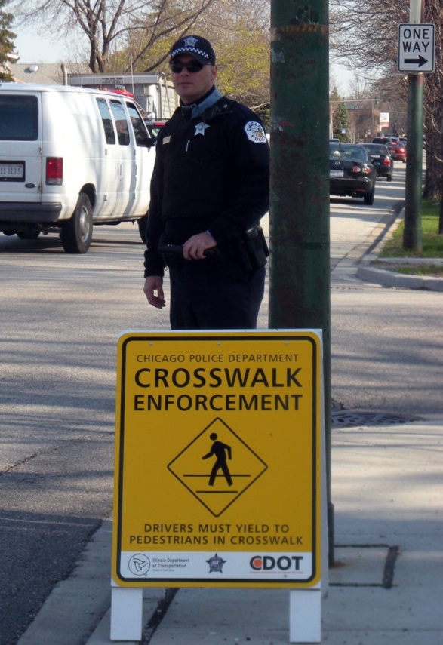
Yielding to Pedestrians
A driver must come to a complete stop (and yield):
When a pedestrian is in a marked crosswalk.
On school days, when children are in close proximity to a school zone crosswalk.

Slide 26
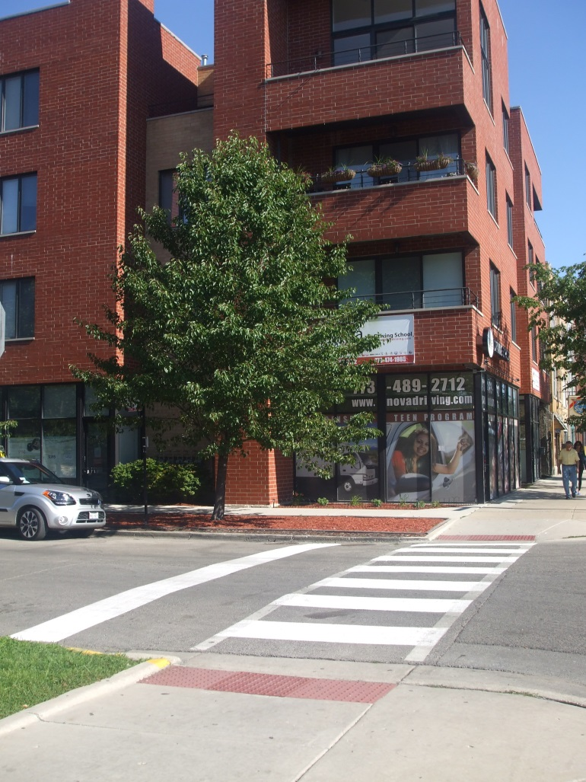
Yielding to Pedestrians
A driver must yield to a pedestrian:
When a pedestrian is in an unmarked crosswalk on the driver’s side of the roadway and there are no traffic control signals.
When making a turn at any intersection.
When making a lawful turn on a red light after coming to a complete stop.

Slide 27
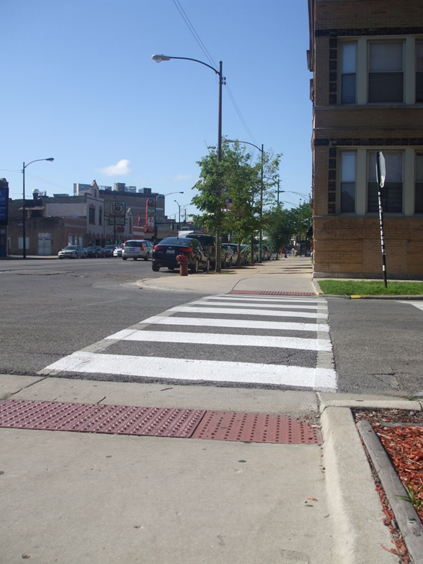
Yielding to Pedestrians
A driver must yield to a pedestrian:
After coming to a complete stop at a stop sign or flashing red signal at an intersection.
When a pedestrian enters a crosswalk before the traffic light changes.
When a pedestrian is walking with a green light, to a walking person symbol or a walk signal.
When a pedestrian is leaving or entering a street or highway.

Slide 28
Passing on Two-Lane Roads
A driver must use caution when passing another vehicle. On a two-lane highway, the left lane should be clearly seen and free of oncoming traffic for a distance great enough to permit passing.
Do not turn back into the right-hand lane until you can see the entire vehicle you have just passed in your rearview mirror.

Slide 29
Passing on Two-Lane Roads
When passing a vehicle, you must return to your lane before you get within 200 feet of an oncoming vehicle. The driver you are passing must not increase speed until you have completed your passing.
Driving off the pavement or main traveled part of the road is not allowed when passing another vehicle on the right or the left.

Slide 30
Passing on Two-Lane Roads
Passing on a two-lane, two-way roadway is not allowed:
In an area marked for no passing by a solid yellow line on your side of the center of the roadway or a DO NOT PASS or NO PASSING ZONE sign.
On a hill or curve where it is not possible to see oncoming vehicles.
Within 100 feet of an intersection or railroad crossing.
When the view is blocked within 100 feet of any bridge, viaduct or tunnel.
When a vehicle has stopped at a crosswalk or intersection to allow a pedestrian to cross.
In a construction zone. All construction zones in Illinois are no passing zones.
Note: Passing is also prohibited in school zones and near school buses that are loading or unloading passengers.

Slide 31
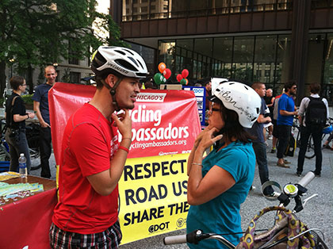
Passing a Bicyclist or Pedestrian: 3 ft. Rule
When passing a bicyclist or pedestrian who is riding or walking on the road or shoulder of the roadway, you must keep a minimum of three feet between your vehicle and the bicyclist or pedestrian.

Slide 32
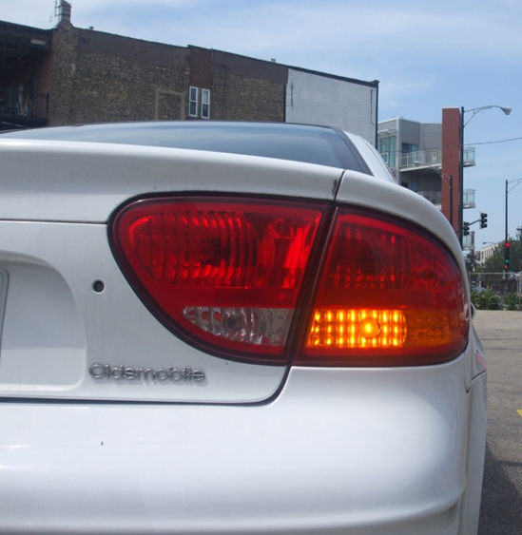
Using Turn Signals
Turn Signals: In a business or residential area you must give a continuous turn signal for at least 100 feet before turning. In other areas the signal must be given at least 200 feet before turning.

Slide 33
School Bus Safety
In most cases, motorists have to come to come to a complete stop for a school bus that has activated its flashing lights and has extended its stop-arm. There is one exception, though, which is listed below:
On a four-lane roadway where a bus is stopped in the opposite direction from which you are traveling, you are not required to stop your vehicle but you should drive with caution.

Slide 34
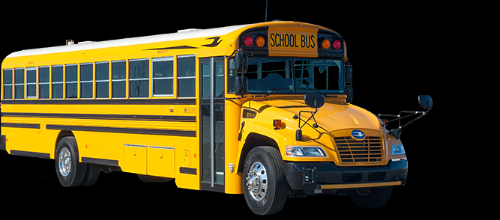
School Bus Safety
In most cases, though, motorists are required to stop for school buses displaying red, flashing lights. Some examples are below:
If you are driving in the same direction as the bus on a four-lane road, you must stop when the red lights are flashing and the stop signal arm is extended.
In addition, on two-lane roads, private roads, and parking lots, you must stop before meeting or overtaking (passing) a school bus loading or unloading passengers.

Slide 35
School Bus Safety
A warning will be given at least 100 feet (200 feet in rural areas) in advance of a stop. The bus driver will flash amber and red lights on the front and rear of the bus.
The stop signal arm will be extended after the school bus has come to a complete stop. You must then come to a complete stop. You must remain stopped until the stop signal arm is no longer extended and the flashing lights are turned off or the driver signals you to pass.

Slide 36
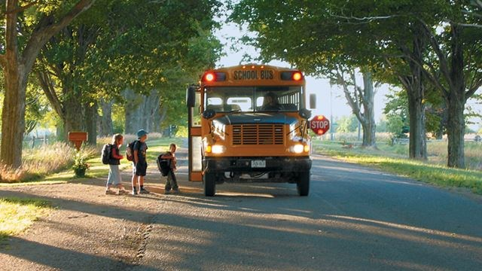
School Bus Safety--Penalties
Your driver’s license or vehicle registration will be suspended [for one month to three months] and you will pay a minimum $175 fine if you are convicted of illegally passing a stopped school bus.

Slide 37
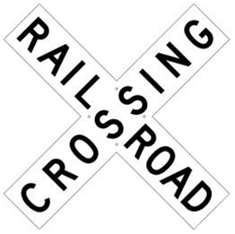
Railroad Crossing Safety
When approaching a controlled railroad crossing (which features lights and/or gates) or an uncontrolled railroad crossing (no lights or gates) and the devices are not activated, you should slow down and look in both directions on the track for oncoming trains or railroad equipment.
If safe to do so, proceed with caution across the railroad crossing.

Slide 38
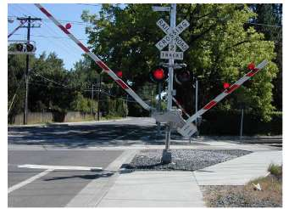
Railroad Crossing Safety
At a controlled crossing (featuring lights and gates), you must stop if the crossing gate is lowered or a signal is flashing.

Slide 39
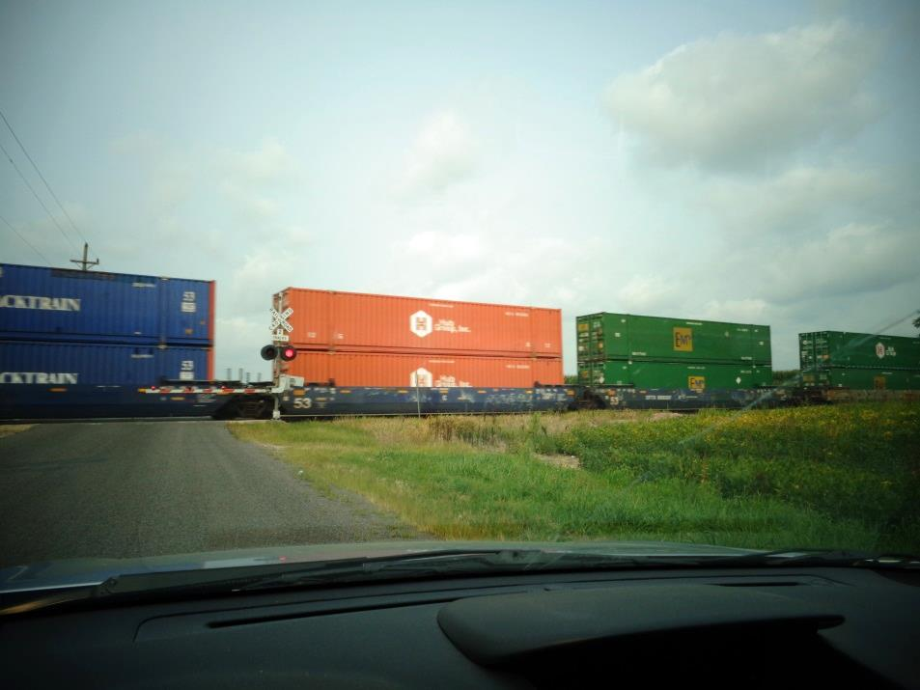
Railroad Crossing Safety
Drivers should stop 15-50 feet away from the crossing if there is a stop sign, the electric signal is flashing, or the crossing gate is lowered.

Slide 40
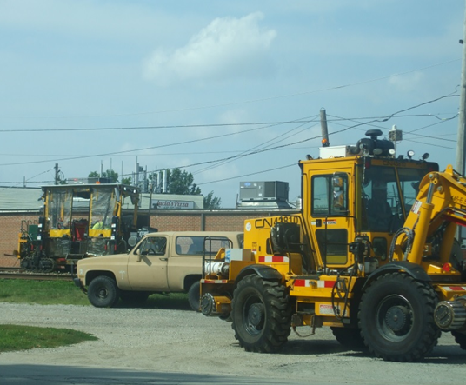
Railroad Crossing Safety
Proceed only after the gate is all the way up, the lights are no longer flashing, and you have visually checked all the tracks for any additional oncoming trains or railroad equipment.

Slide 41
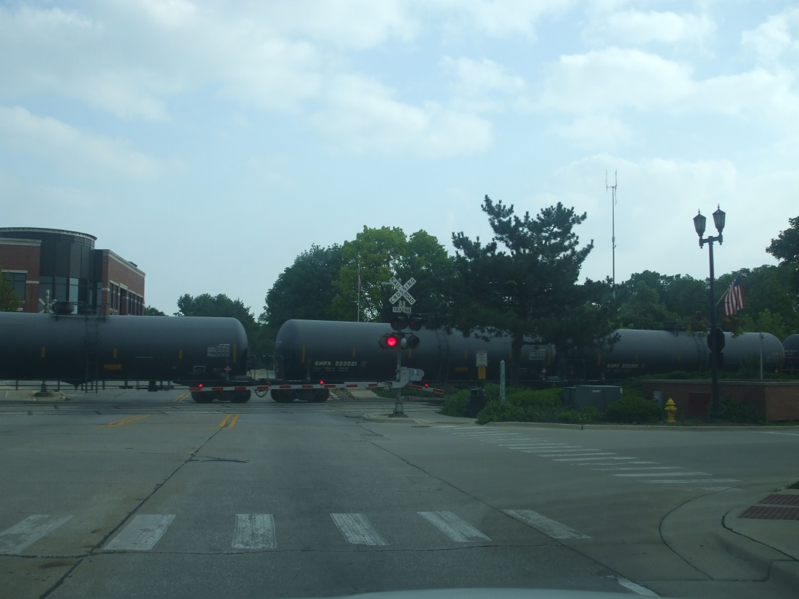
Railroad Crossing Safety
Before crossing the tracks, make sure that there is enough room on the other side of the tracks so that you do not end up stuck on the tracks—and in the path of a train. If you are not certain that enough space exists, don’t cross the tracks.

Slide 42
Stop Before Entering Road When Leaving Parking Lot or Driveway
In urban areas, drivers must come to a complete stop before entering the sidewalk area when moving out of an alley, building, private road or driveway. If there is no sidewalk, stop at a point nearest the street or roadway where there is a view of approaching traffic. After stopping, yield the right-of-way to pedestrians and all vehicles.

Slide 43
Hill Parking
Any time you park on a hill, you should put the gear selector in park and set the parking/emergency brake if necessary. When starting your vehicle from an uphill or downhill location, you should release the parking/emergency brake, activate the correct directional (turn) signal, check for traffic, and proceed when it is safe to do so.

Slide 44
Hill Parking
If you park on a street with curbing and your vehicle is facing downhill, turn the front wheels toward the curb so your vehicle will roll toward the curb.
If you park your vehicle facing uphill and there is a curb, turn the front wheels away from the curb.
If you park on a street without curbing, turn the wheels toward the side of the road on which you are parked.
Hint: For uphill parking, think of the phrase “up, up, and away”; you’ll turn your wheels away from the curb when parking uphill on a road where a curb is present.

Slide 45
Hill Parking at a Glance
Note: When parking on roads where curbs are present, drivers must park within 12 inches of the curb. Cars must be parked in the same direction as the flow of traffic.

Slide 46
Prohibited Parking
Standing or parking a vehicle, whether occupied or not, is prohibited:
In front of a public or private driveway.
Within 15 feet of a fire hydrant.
Within 20 feet of a fire station driveway or crosswalk at an intersection.
Within 30 feet of a STOP sign, YIELD sign or traffic control signal.

Slide 47
Dropping Off Passengers
When dropping off passengers at the curb, drivers should remind their passengers to exit on the curb side rather than on the street side.
Exiting on the curb side reduces the chance of a collision between the person leaving the vehicle and a car, motorcycle, or bicycle in the traffic lane.

Slide 48
Module 1 Quiz
If you see an emergency vehicle approaching that has its flashing lights on and is using its siren, a driver should:
( ) Speed up to get out of the way.
( ) Continue driving at the same speed.
( ) Pull over to the right-hand edge of the highway and stop, if it’s possible and safe to do so.
In a situation like this, the goal is to move out of the way of the emergency vehicle so it can get to its destination as quickly as possible. If you hear/see an emergency vehicle approaching, pull over to your right and yield as soon as it is safe to do so. After the emergency vehicle has passed, you may continue driving. Speeding up might be dangerous and also could leave you to pay a speeding ticket. Staying at the same speed will block the emergency vehicle’s path of travel, and may also result in a ticket.

Slide 49
Module 1 Quiz
If a driver is passing another car, he or she should not return to the right lane until he or she is able to see the other car that was passed in the rearview mirror.
( ) True
( ) False
True. When passing, you can safely assume that you are far enough ahead and have enough space to change back to your original lane if you can see the car you passed in your rearview mirror. If you cannot see them, they are still too close and you risk hitting them if you change lanes too soon.
2, A person is prohibited from driving a motor vehicle (even short-term) unless he or she has a valid driver’s license that is specified for that type of vehicle.
( ) True
( ) False
True. You may not drive any vehicle you are not specifically licensed for. For example, if you have a regular Class D license, you may not drive vehicles requiring special licenses such as motorcycles or school buses.

Slide 50
Module 1 Quiz
Which way should the front wheels be turned when parking uphill with a curb?
( ) Toward the curb
( ) Away from the curb
( ) Straight ahead
If you are parking uphill with a curb, you should turn your wheels away from the curb. Then, let your car slowly roll backwards until the back of the front tire is touching the curb, which will block it from rolling. Then you can engage the emergency brake/parking brake.
**When parking on a hill, the ONLY time your wheels should face AWAY from the curb is when going uphill with a curb. In all other cases turn your wheels TOWARD the curb or where the curb would be.
A person with a Class D license can drive a vehicle with gross weight up to but not exceeding :
( ) 5,000 lbs.
( ) 16,000 lbs.
( ) 28,000 lbs.
Class D licenses cover vehicles up to 16,000 pounds. Vehicles above 16,000 pounds, such as semi-trucks and heavier delivery trucks, require additional licensing.

Slide 51
Module 1 Quiz
What direction should your wheels be facing if you’re parking downhill with a curb?
( ) Toward the curb
( ) Away from the curb
( ) Straight ahead
Your wheels should be facing the curb, with the front of the front tire actually touching the curb to prevent rolling.
2, How much space is a driver required to keep between their vehicle and a bicyclist when attempting to pass?
( ) A minimum of 8 feet
( ) A minimum of 3 feet
( ) A minimum of 1 foot
To ensure safety and adequate clearance, and also in order to not startle or frighten a cyclist, you must leave at least 3 feet of space between your vehicle and a cyclist when passing.

Slide 52
Module 1 Quiz
47. When two or more road users arrive simultaneously at at stop sign, who should go first?
( ) The person furthest right should proceed first.
( ) The person furthest left should proceed first.
( ) Both vehicles may proceed with caution.
( ) You may sound your horn to alert the other driver that you plan to go first.
In general, whoever arrives first proceeds first. If you arrive at the same time as another driver or road user, the person on the right should go first.
52. In order to avoid a $175 fine and a 3-month suspension of driving privileges, when you see a school bus turn on its red flashing lights and extend its stop sign, who must stop?
( ) If on a two-lane road, both lanes of traffic must stop until the bus turns off the red flashing lights and retracts (folds up) the stop sign.
( ) If on a four-lane road, traffic going in the same direction must stop and wait, while traffic going in the opposite direction must slow down and proceed with caution.
( ) Both of the above are true.
( ) None of the above are true.
If a bus has its red flashing lights on and its stop sign extended, the ONLY situation where you can continue driving is if you are on a four-lane road going in the opposite direction. In all other situations, you must stop completely and wait for the bus driver to retract the stop sign and turn off the red, flashing lights.

Slide 53
Module 1 Quiz
It is prohibited for drivers to wear headphones or a headset or to have a television screen visible from the driver’s seat.
( ) True
( ) False
True. The driver may never have a television screen visible to him or her while driving. Headsets such as headphones are also prohibited. For drivers 19 and older, a hands-free, single-sided device like a bluetooth earpiece is allowed (though discouraged).
After a train finishes crossing the tracks, how should you proceed?
( ) As soon as the train clears the crossing, you may proceed.
( ) After checking to make sure there are no more trains approaching, you may proceed with caution.
( ) It is best to simply follow the vehicle ahead of you.
Always wait until the railroad signals (e.g., flashing lights) have stopped flashing and the railroad gates have returned to the upright position. Then, after checking in both directions for an approaching train, you may proceed with caution.

Slide 54
Module 1 Quiz
If you encounter a railroad that does NOT have a warning system (e.g., railroad gates or flashing lights), you should:
( ) Accelerate in order to cross tracks as quickly as possible.
( ) Continue driving at your normal speed.
( ) Look and listen for signs of a train, decrease your speed in case you may need to stop, the proceed when it is safe to do so.
Slow down as you approach the railroad crossing in case you need to stop quickly. Never cross a railroad track before checking in both directions to make sure there is no approaching train.

Slide 55
Module 1 Quiz
For children that are under 8 years of age, Illinois law requires that they be secured by a child-restraining device or seat belt only if they are traveling:
( ) A child under age 8 is always required to be in a child-restraint device, in all seating positions.
( ) In the front seat only.
( ) In the back seat only.
( ) This is not a requirement in Illinois.
All vehicle occupants must wear a seat belt/restraining device when traveling in a motor vehicle in Illinois. For children under age 8, they must be in a child-restraint device such as a safety seat or booster seat.
In Illinois, any person operating a motor vehicle and all passengers are required by law to wear a seat belt.
( ) True
( ) False
True. In Illinois, the driver and all passengers MUST wear a seatbelt. Also, you may only have as many passengers as you have seatbelts. Seatbelts greatly reduce the risk and severity of injury if a collision occurs.

Slide 56
Module 1 Quiz
Your license may be suspended for at least 3 months if you are found guilty of passing a school bus when it is picking up or dropping off passengers.
( ) True
( ) False
True. Illegally passing a school bus picking up or dropping off children is dangerous. Children are very unpredictable on the roadway. You must always stop and wait when a school bus its displaying its flashing, red lights and has its stop-arm extended. The ONLY exception is if you’re on a road with 4 or more lanes and you are traveling in the opposite direction in which case you can continue driving with caution. Everyone else must stop until the bus retracts its stop sign and turns off the flashing, red lights.

Slide 57
Module 1 Quiz
If a train is approaching, all motor vehicles must stop
( ) Between 15 and 50 feet from the railroad crossing.
( ) Between 5 and 10 feet from the railroad crossing.
( ) 10 feet away from the railroad crossing.
Drivers should stop at LEAST 15 feet before train tracks in order to see the full width of the railroad crossing and determine whether additional trains might approach. Stopping too close to the tracks could cause a vehicle to be struck by a portion of the train that overhangs the tracks.
You may legally pass another vehicle by using the shoulder of the road
( ) True
( ) False
False. You may NEVER pass another vehicle by using the shoulder of the road. The shoulder is to be used for emergencies only, such as mechanical breakdowns, flat tires, etc.
If you see any authorized vehicle conducting highway maintenance or construction that has amber (yellow) oscillating, rotating, or flashing lights, you must, by law, yield the right-of way.
( ) True
( ) False
True. Authorized maintenance and construction vehicles have the right of way. When you see one, or if you are in a construction zone, you must slow down, change to a lane away if possible, discontinue use of any wireless, hand-held device, and proceed with caution.
If you are driving in an urban setting, when you leave an alley, private road, or driveway, you are required to
( ) Stop only if there are vehicles approaching.
( ) Stop before reaching the sidewalk and yield to pedestrians and vehicles before proceeding.
( ) Honk your horn to alert pedestrians and other vehicles, then proceed quickly.
You must come to a complete stop after leaving an alley or private road. It’s hard for you to see cross-traffic, and for them to see you until you are near the intersection. To be safe, you must stop and yield, and then proceed driving.
Before making a left or right turn in a residential or business area, you must give a continuous turn signal:
( ) At least 100 feet before turning.
( ) A minimum of 50 feet from the intersection.
( ) Only if there are are cars approaching from the opposite side.
In order to help other drivers predict your path of travel, you must signal at least 100 feet in advance when making a left or right turn. If you are in a rural area, you must signal for 200 feet.

