Slide 1
Written exam preparation

Slide 2
Module 2
The smarter way to learn how to drive

Slide 3
Navigation Menu
DUI Penalties
Additional Laws
Traffic Crashes
Sharing the Road: Large Vehicles
Driver’s License Revocation
Driving Near Motorcycles
Driver’s License Suspension
Driving Near Bicycles
The smarter way to learn how to drive!
Driving Under the Influence (DUI)

Slide 4
Introduction
To navigate through the presentation, click the forward and back arrows on the screen.
We’re confident that you’ll find our Online Knowledge Preparation Exam efficient and effective mean.

Slide 5
Additional Laws
Back to Menu

Slide 6
Illinois law states that motorists cannot:
Wear a headset while driving. (The use of a single-sided headset or earpiece with a wireless/cellphone device is permitted while driving.) Motorcycle, motor-driven cycle and moped operators may use intercom helmets that permit drivers and/or passengers to speak to one another.
Drive onto a railroad crossing, enter an intersection or drive within a marked crosswalk unless there is enough space to allow passage of other vehicles, pedestrians or railroad trains.
Back up on any shoulder or roadway of any controlled access roadway.
Back to Menu

Slide 7
Sharing the Road: Large Vehicles
Back to Menu

Slide 8
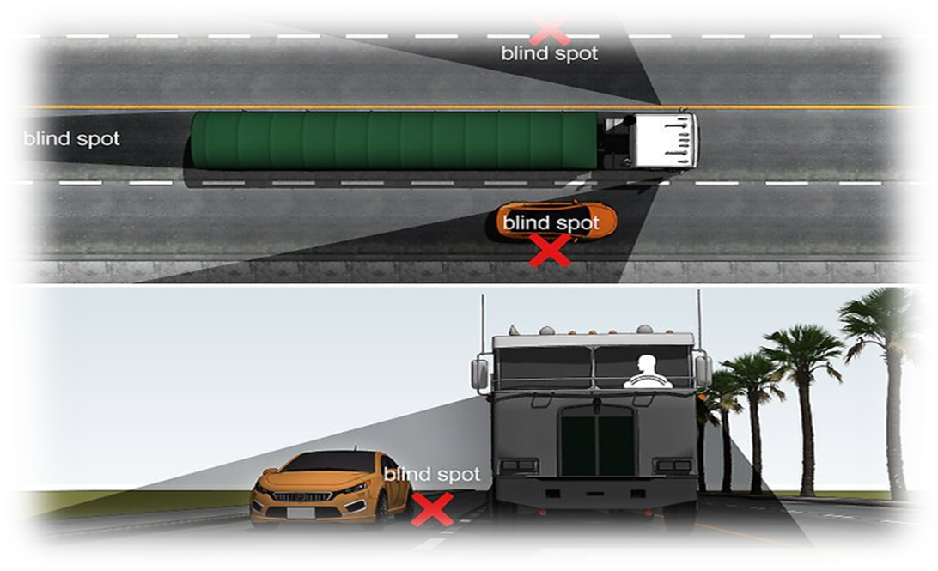
When sharing the road with trucks, buses or other large vehicles, follow these tips:
When following a large vehicle, stay out of its blind spots. If you want to pass, pass on the truck’s left side. Position your vehicle so the driver can see it in the side mirrors.
Back to Menu

Slide 9
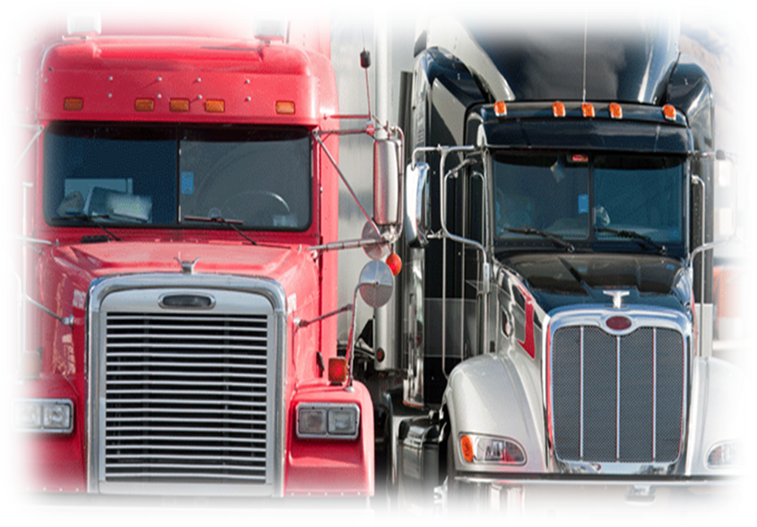
Pay close attention to turn signals, and give large vehicles plenty of room to maneuver and make turns. Large vehicles make wide right turns and sometimes leave an open space to the right just before the turn.
Size and weight affect a vehicle’s ability to maneuver and stop. Always allow extra space for large vehicles.
Back to Menu

Slide 10
Driving Near Motorcycles
Back to Menu

Slide 11
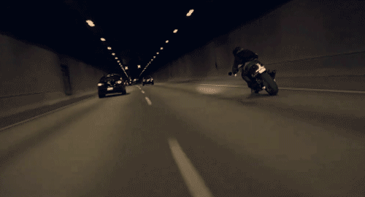
Motorcycle riders have the same rights and responsibilities as other roadway users. Because of their size and vulnerability in a crash, it is important to pay special attention to motorcycles.
Intersections: More than 50 percent of all motorcycle collisions occur at intersections. The most common situation occurs when an oncoming automobile makes a left turn in front of a motorcycle.
Back to Menu

Slide 12
Lane Sharing: Although there may be enough room in the traffic lane for an automobile and a motorcyclist, remember that the motorcyclist needs the room to maneuver safely and is entitled to the entire lane. Do not share the lane.
Following Distance: Allow at least three to four seconds of following distance when behind a motorcycle. In dry conditions motorcycles can stop more quickly than a car.
Back to Menu

Slide 13
Driving Near Bicycles
Back to Menu

Slide 14
Drivers must yield the right-of-way to a bicyclist just as they would to another vehicle.
When passing a bicyclist, motorists must do so slowly and leave at least 3 feet of passing space.
Back to Menu

Slide 15
Driving Under the Influence (DUI)
Back to Menu

Slide 16
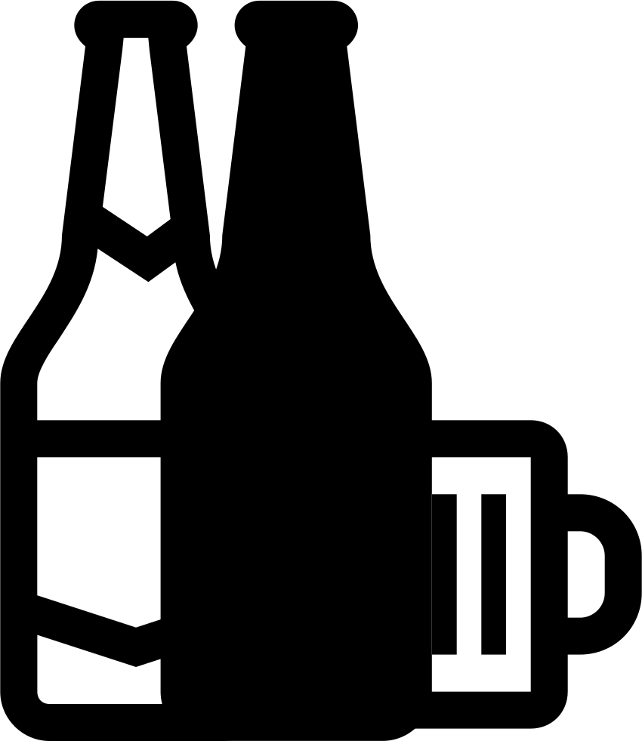
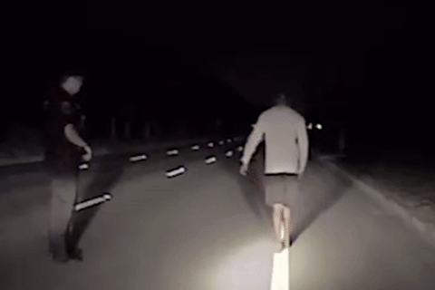
Alcohol is the number one killer on American roadways. Alcohol affects your vision and slows your reaction time so it takes longer to act in an emergency. Alcohol affects your driving even if you are below the level of illegal intoxication.
Drinking even a small amount of alcohol increases your chances of causing a crash. Stay safe on the roads: Do not drink and drive.
Back to Menu

Slide 17
DUI: Blood-Alcohol Concentration (BAC)
Blood-alcohol concentration is a measurement of the amount of alcohol in your system based on a test of your breath, blood or urine. It is illegal to drive if your BAC is .08 percent or more.
However, you can be convicted of Driving Under the Influence (DUI) if your BAC is less than .08 percent and your driving ability is impaired.
Back to Menu

Slide 18
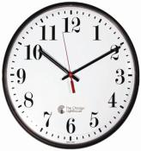
Alcohol Awareness: The Role of Time
Time is the only way to remove the effects of alcohol. Food, coffee, and showers do not speed up the elimination of alcohol from the body.
Back to Menu

Slide 19
Other Drugs: Marijuana/Cannabis
It is illegal to operate a motor vehicle on Illinois highways with a cannabis tetrahydrocannabinol concentration (THC) of either 5 nanograms or more per milliliter of whole blood or 10 nanograms or more per milliliter of other bodily substance.
Back to Menu

Slide 20
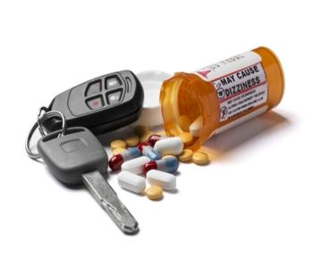
DUI: Other Drugs; Implied Consent Law
Other Drugs: It is illegal to operate a motor vehicle on Illinois highways with any trace of a controlled drug, substance or intoxicating compound in your blood.
Implied Consent Law: When driving on Illinois roadways, you automatically consent to submit to certain tests. These can include breath, blood and/or urine tests to determine if you were drinking or using any other drug or intoxicating compound before or while driving.
Back to Menu

Slide 21
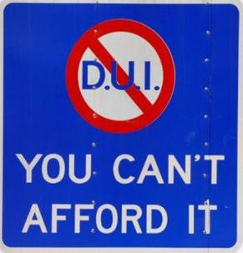
DUI Penalties: Failing or Refusing Sobriety Test
Statutory Summary Suspension/Revocation Law: (Note: These consequences apply following a traffic stop, regardless of a conviction in court.)
If you are arrested for driving with a BAC of .08 percent or more and/or any impairing drug in your system, your driving privileges will be suspended for six months.
If you refuse to submit to testing, your driving privileges will be suspended for one year.
Back to Menu

Slide 22
If you are a second offender within a five-year period, your privileges will be suspended for one year if you fail the test or three years if you refuse to test. A test refusal may be used as evidence against you in the DUI court case.
Rule to Remember: DUI=LOP (Lots of Penalties)
The cost of a taxi ride is far less expensive than the fines, court costs, lawyer fees, and economic costs a person faces after being stopped while under the influence and charged with DUI.
Back to Menu

Slide 23
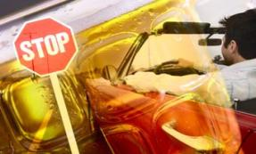
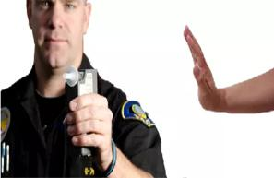
DUI Penalties: Refusing Test When Serious
Injuries Occurred=1 Year Revocation
As you learned earlier, a person who refuses to submit to a chemical test typically faces a one-year license suspension. However…
If you refuse to submit to chemical testing after being involved in a crash where serious personal injury or death was involved, your driving privileges will be revoked for a minimum of one year.
Back to Menu

Slide 24
DUI: License-Related Penalties
Upon Conviction in Court
In addition to a statutory summary suspension/revocation after a DUI traffic stop, you may be convicted of driving under the influence of alcohol, other drugs and/or intoxicating compounds.
A DUI conviction results in a revocation of driving privileges:
A first conviction results in a minimum one-year revocation.
A second conviction within 20 years results in a minimum five-year revocation.
A third conviction results in a minimum 10-year revocation.
A fourth and subsequent conviction results in a lifetime revocation.
Back to Menu

Slide 25
DUI Consequences: SR-22 Insurance and
LOP (Lots of Penalties)
A DUI conviction also subjects you to filing Financial Responsibility Insurance (SR-22) for three years. Before your driving privileges are restored, you must undergo an alcohol/drug evaluation and successfully complete a rehabilitation or alcohol/drug education program, pay a reinstatement fee and/or meet other requirements.
Back to Menu

Slide 26
Traffic Crashes
Back to Menu

Slide 27
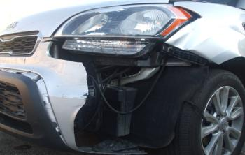
Traffic Crashes/Crash Reports: After a crash occurs, a motorist should:
Contact the police by dialing 911.
Help any injured person at the scene.
Activate the hazard flashers.
Exchange insurance information and
vehicle registration information with the other driver.
Ask all those involved for their names, addresses, phone numbers, driver’s license numbers and license plate numbers.
Obtain a police report from the investigating officer.
Back to Menu

Slide 28
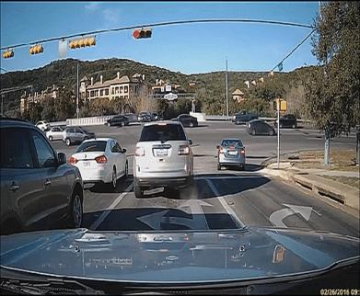
Motorists Responsibilities
Regardless of fault, a crash report must be filed by the driver of a vehicle if the crash involves death, bodily injury or property damage of more than $1,500. (If any vehicle involved in the crash is uninsured, a report must be filed for $500 or more.)
Back to Menu

Slide 29
Notify the police immediately. Many towns and cities require a report if a crash occurs within their limits. If an officer is not at the scene of the crash, a report must be made at the nearest police station as soon as possible. If in a rural area, the county sheriff or Illinois State Police must be notified. If the driver is unable to make the report and there is a passenger, the passenger must make the report.
A report also must be made to the Illinois Department of Transportation. This confidential report must be sent no later than 10 days after the crash. The form may be obtained from a police officer or an automobile insurance agency.
Back to Menu

Slide 30
Revocation is the indefinite withdrawal of driving privileges by the Secretary of State’s office. To regain your driving privileges, you may be eligible to reapply for a license after a minimum of one year, unless otherwise noted. The Secretary of State will immediately revoke the driving privileges of someone convicted of a moving violation that caused a crash and resulted in the death of another person.
Driver’s License Revocation
Back to Menu

Slide 31
Other offenses for which your driver’s license may be revoked include, but are not limited to:
Aggravated DUI — Causing personal injury or death as a result of a DUI; having a prior conviction of reckless homicide or aggravated DUI involving a death and committing a DUI; receiving a third or subsequent DUI conviction; committing a DUI without a valid license, permit or vehicle insurance; or committing a DUI violation while transporting children in a school bus.
Aggravated Reckless Driving — Driving resulting in great bodily harm, permanent disability or disfigurement to another person.
Drag Racing or Street Racing — Illegally racing with another vehicle.
DUI — Driving under the influence of alcohol, marijuana, other drugs and/or intoxicating compounds.
Leaving the Scene — Leaving the scene of a crash that killed or injured someone.
Back to Menu

Slide 32
Suspension is a temporary loss of driving privileges. When the suspension is for a specific length of time, you may regain your driving privileges after your suspension has ended and you have paid a reinstatement fee. In other cases, your driver’s license will not be returned until you meet a requirement of Illinois law.
Driver’s License Suspension
Back to Menu

Slide 33
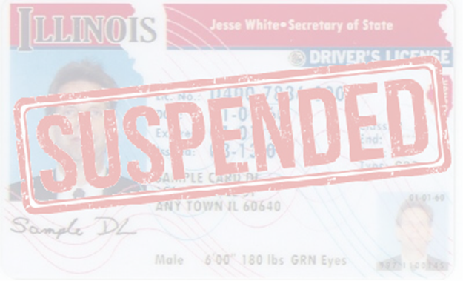
Offenses for which your driver’s license may be suspended include, but are not limited to:
Drug/Alcohol Test Failure — Failure of chemical testing following a DUI arrest revealing a BAC of .08 percent or more, a THC level of either 5 Nano grams or more per milliliter of whole blood or 10 Nano grams or more per milliliter of other bodily substance or any trace of a controlled substance, or intoxicating compound.
Drug/Alcohol Test Refusal — Refusal to test for drugs or alcohol after being arrested for DUI in Illinois or another state.
School Bus Violations — Failure to stop for a school bus picking up or dropping off children, or failure to pay five or more violations of yielding to a stopped school bus when recorded by a camera.
Traffic Violations — Three traffic violation convictions during a 12-month period. (If you are under age 21 at the time of arrest, two traffic violations within any 24- month period.)
Zero Tolerance Violation — An alcohol violation by a person under age 21.
Back to Menu

Slide 34
Thank you!
support@idrivio.com
www. Idrivio.com

