Slide 1
Written exam preparation

Slide 2
Module 3
The smarter way to learn how to drive

Slide 3
Navigation Menu
Traffic Signals
Traffic Signs
Safe Driving Tips
Regulatory Signs
Equipment
Warning Signs
Guide Signs
The smarter way to learn how to drive!

Slide 4
Introduction
To navigate through the presentation, click the forward and back arrows on the screen.
We’re confident that you’ll find our Online Knowledge Preparation Exam efficient and effective mean.

Slide 5
Traffic signs
Traffic signs typically fit into one of three broad categories: Regulatory Signs, Warning Signs, or Guide Signs/Informational Signs.
Back to Menu

Slide 6
Regulatory signs
Regulatory signs indicate what motorists must do or must not do and must be obeyed. The next few slides will show you a variety of regulatory signs that you will see on the road.
Back to Menu

Slide 7
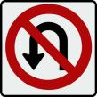
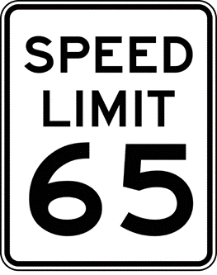
Regulatory signs typically are:
Red and white (such as a Stop sign)
Red, white, and black (such as a No U-Turn sign)
Black and white (such a Speed Limit sign).
Back to Menu

Slide 8
Stop Sign
This eight-sided red sign means STOP. You must make a complete stop at the marked stop line (the line painted on the ground). If there is no stop line, stop before entering the crosswalk. If there is no crosswalk, stop before entering the intersection.
Back to Menu

Slide 9
When you reach a stop sign, yield the right-of-way to pedestrians and closely approaching traffic.
If it is an all-way STOP sign, wait your turn.
Back to Menu

Slide 10
Yield Sign
The three-sided (triangle) sign tells you to give the right-of-way to all vehicles and pedestrians near you. Slow down to a safe speed and stop if necessary.
When stopping, do so at a marked crosswalk or before entering the intersection
Back to Menu

Slide 11
You also may see YIELD signs on expressway ramps. These signs are posted when there is no extra lane where drivers may speed up to merge with expressway traffic.
Back to Menu

Slide 12
Do not enter
This sign is posted on one-way streets and other roadways you are not allowed to enter. You also will see this sign if you try to enter an expressway ramp in the wrong direction.
Back to Menu

Slide 13
Speed Limit
The speed limit sign shows the fastest speed at which you can travel. Driving faster than the speed limit is illegal.
Some signs show maximum and minimum speed limits for all types of vehicles on freeways and limited access highways.
Back to Menu

Slide 14
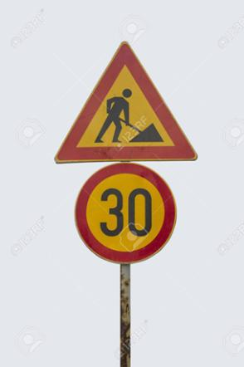
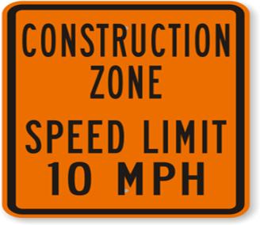
In construction and maintenance zones, posted speeds legally reduce the speed limit on that portion of the highway. Unless necessary for safety, driving slower than the minimum is illegal.
Back to Menu

Slide 15
Wrong way
This sign tells you that your vehicle is moving in the wrong direction.
You will see this sign on expressway ramps a short distance past the DO NOT ENTER sign. You also might see this sign if you turn the wrong way into a one-way street, alley or driveway.
Back to Menu

Slide 16
No
u-turn
These signs are posted on divided highways or expressways to indicate that U-turns are not permitted.
Back to Menu

Slide 17
You may see one where there is an opening in the divided highway that leads to the other side.
These openings are for authorized vehicles only such as police cars, ambulances, snow plows, construction/maintenance equipment and other emergency vehicles. You may not use this opening.
Back to Menu

Slide 18
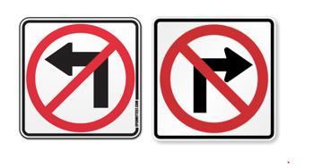
No Right or left turn
These signs indicate that right turns (or left turns) are not allowed
Back to Menu

Slide 19
Warning signs
Warning signs alert you to road conditions and dangers ahead. Warning signs usually are yellow or orange in color. These signs are usually diamond-shaped and warn you about road hazards, construction sites, schools or other situations that require your special attention.
Back to Menu

Slide 20
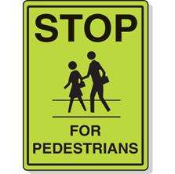
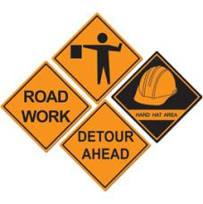
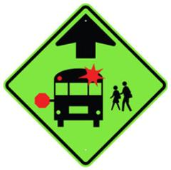
While most warning signs are yellow, some Illinois communities may have fluorescent yellow-green pedestrian and school signs.
Construction and maintenance warning signs are orange.
Back to Menu

Slide 21
Pedestrian
crosswalk
This sign tells you there is a crosswalk. However, it may not be at an intersection so you must watch both sides of the street for pedestrians.
Back to Menu

Slide 22
These signs warn you of school areas and crossings. Stay alert and watch for children.
Adult school crossing guards, auxiliary police or police officers often supervise these street crossings when students are going to and from school.
School
crossing
Back to Menu

Slide 23
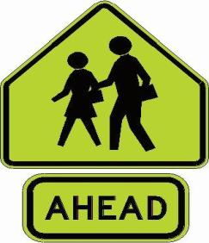
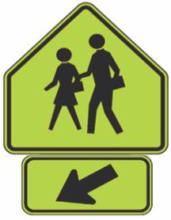
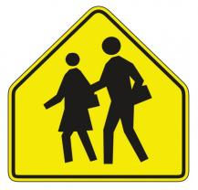
The three signs below show two children walking. They warn of school crossings ahead or of school buildings or grounds next to the roadway.
Back to Menu

Slide 24
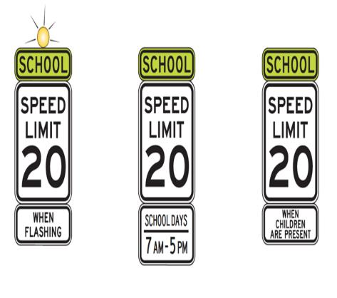
School Speed limit
signs
These two signs are used in areas where a reduced-speed school zone has been established.
Back to Menu

Slide 25
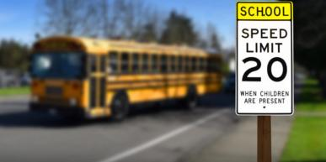
The posted speed applies only on school days when children are present (usual school hours are 7 a.m. to 4 p.m., but hours may vary), where a potential hazard exists because of the children’s close proximity to traffic, or when a light is flashing.
Back to Menu

Slide 26
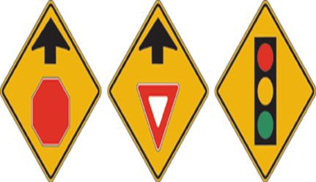
Stop ahead
Yield ahead
Signal ahead
These signs warn of traffic controls ahead. Although the traffic signal may not yet be visible, the traffic signs are close enough to require you to start slowing down.
Advance warning signs also are used in high-speed areas because of the longer distance needed to slow down or stop.
Back to Menu

Slide 27
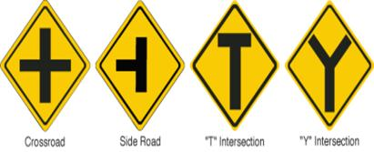
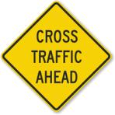
Signs warn you of intersections ahead where traffic may exist or where a right or left turn may be required. A sign naming the intersecting road also may be posted.
The two intersections shown here are the Crossroad and the Side Road.
Intersection ahead
Back to Menu

Slide 28
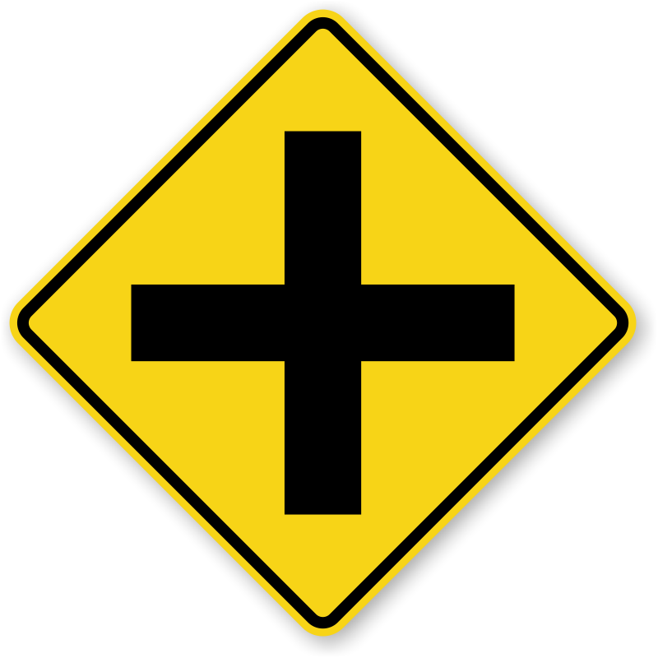
The Crossroad sign shows two streets that intersect at a typical intersection.
The intersection could be uncontrolled (with no stop signs, yield signs, or traffic signal lights) or controlled (with stop signs, yield signs, or traffic signal lights).
Cross
road
Back to Menu

Slide 29
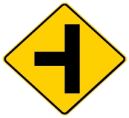
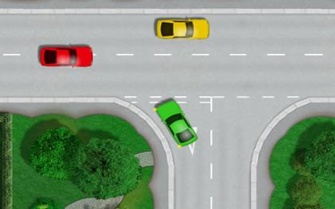
Side
road
The Side Road sign shows a road that terminates when it intersects with a second road.
Back to Menu

Slide 30
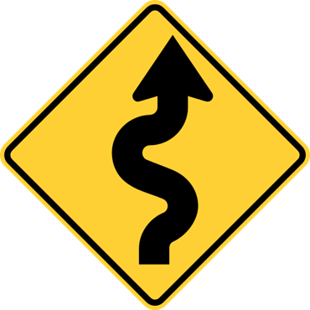
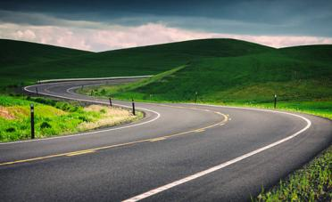
Winding
Road
ahead
Certain signs are posted before turns and curves. The shape of the arrow tells you what to expect.
The “Winding Road Ahead” sign shows that the road will curve both left and right.
Slow down before the curve; sudden braking could cause a skid or locked wheels.
A sign showing the maximum safe speed might be posted below the sign.
Back to Menu

Slide 31
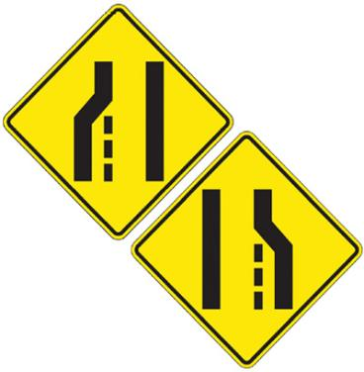
Reduction in lanes
These signs are used on multi-lane roads to warn you of a reduction in the number of traffic lanes in the direction you are traveling.
Hint for remembering the sign: If you trace over the image on the sign, you form the letter “R,” which is the first letter of the answer: “Reduction in Lanes”!
Back to Menu

Slide 32
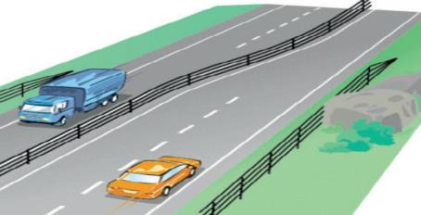
When you see the Reduction in Lanes sign, be prepared to change lanes or to allow other vehicles to merge into your lane.
Drivers of all vehicles may need to adjust their speed and position to avoid a collision with another vehicle.
Back to Menu

Slide 33
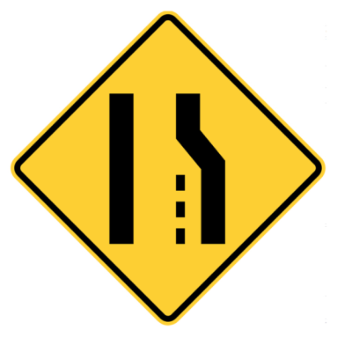
Reduction in lanes
The sign at right is another way of communicating to drivers that they need to make a lane change if they want to continue in their direction of travel.
Back to Menu

Slide 34
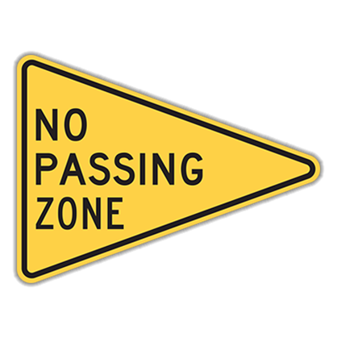
No passing
This sign is used on two-lane, two-way roads. It warns you not to pass. The sign is posted at the beginning of a no passing zone.
Back to Menu

Slide 35
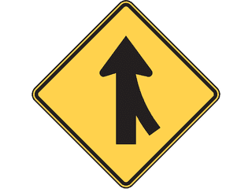
This sign tells you that two lanes of traffic going the same direction will soon merge into one lane. Be ready to either change lanes or allow other traffic to merge into your lane.
Merging lanes
Back to Menu

Slide 36
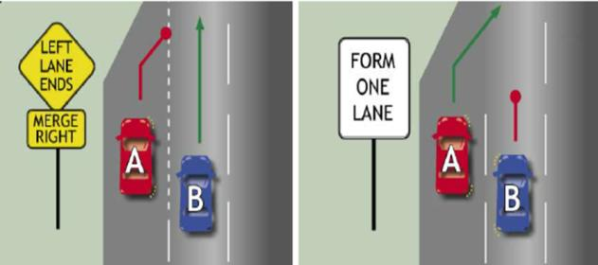
Merge signs appear on expressways just before expressway ramps. The driver on the expressway slows down to let the driver on the ramp merge.
Back to Menu

Slide 37
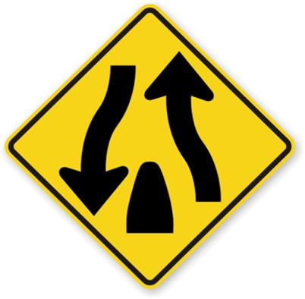
Divided highways have a center strip that separates traffic going in opposite directions.
The first sign is posted before a divided highway begins.
Divided
highway
Back to Menu

Slide 38
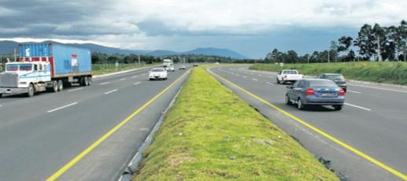
This sign is posted just before the divided highway ends.
Be careful as you near the end of a divided highway. Two-way traffic will begin again.
Back to Menu

Slide 39
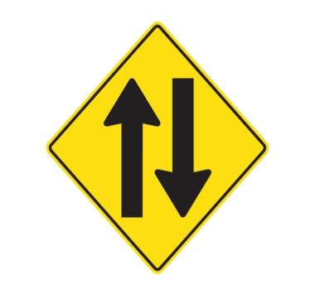
Two-way traffic
This sign tells you that you are leaving a divided roadway and will be driving on a two-way highway with two-way traffic.
Back to Menu

Slide 40
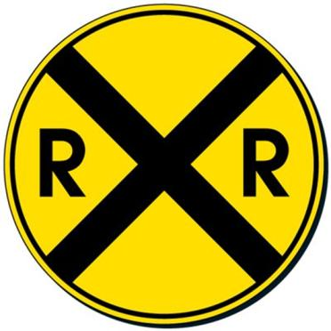
This sign means Railroad Crossing Ahead. It is an advance warning sign that means a railroad track will cross the roadway ahead. In rural areas the sign may be up to 750 feet in advance of the railroad crossing.
Railroad
Crossing
ahead
Back to Menu

Slide 41
When you see this sign, especially in rural areas, slow down, look and stop if necessary. Roll your vehicle windows down and listen to see if a train is coming.
If a train is approaching, stop and wait. Never try to race a train to a railroad grade crossing.
Back to Menu

Slide 42
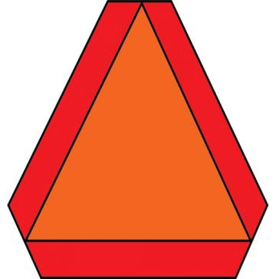
Slow
Moving
vehicle
A vehicle displaying this sign is moving slowly. Drivers must slow down and may pass only when safe and legal to do so.
The sign is typically displayed on tractors.
Back to Menu

Slide 43
Guide signs / informational signs
Back to Menu

Slide 44
Traffic signals
Traffic signals must be obeyed at all times (unless a police officer is directing traffic).
Leaving the roadway to avoid a traffic signal (such as a red light) is illegal.
Back to Menu

Slide 45
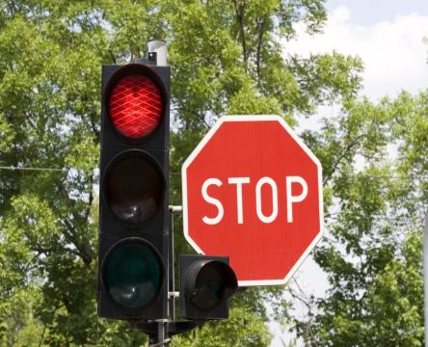
stop
Come to a complete stop
Stop behind marked stop line or crosswalk
If no stop line, stop before entering the intersection
Back to Menu

Slide 46
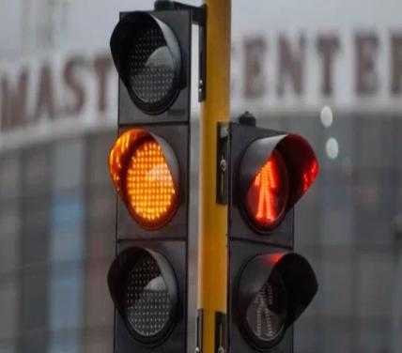
caution
Means caution
Slow down and prepare to stop safely
If too close to stop when yellow appears, proceed carefully through the intersection
Back to Menu

Slide 47
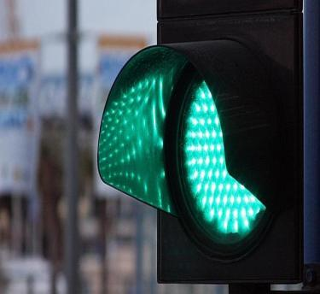
go
Before proceeding on a green light, always check left and right for both pedestrians and vehicles.
Back to Menu

Slide 48
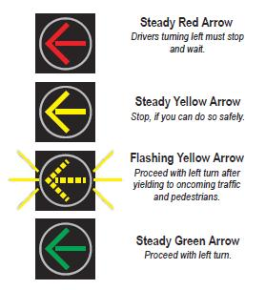
Flashing Lights & Traffic Signal Arrows

Slide 49
Pavement/Road Markings

Slide 50
Safe driving tips
The slides in this section provide a range of tips for driving safely in all conditions, including bad weather.
You’ll learn how to drive safely in rain, snow, fog, and at night.
Back to Menu

Slide 51
Following Distance
Following a vehicle too closely or tailgating is the cause of most rear-end collisions.
Use the three-second rule to determine a safe following distance.
Back to Menu

Slide 52
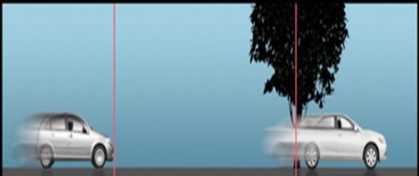
Using the Three-Second Rule
When the driver in front of you passes a fixed object, such as a sign or tree, start counting, “One-thousand one, one-thousand two, one-thousand three.” If you get to the fixed object before “one-thousand three,” you’re following too closely and should reduce your speed.
In adverse weather conditions, you will need a longer following distance, such as a six-second or eight-second following distance.
Back to Menu

Slide 53
Driving in Fog
Driving in the fog is dangerous because your line of sight can become extremely limited. If you must drive in fog, take the following precautions:
Turn off the cruise control if in use and increase your following distance.
Slow down. Drive with your headlights set on dim (low beams), or use fog lights.
Back to Menu

Slide 54
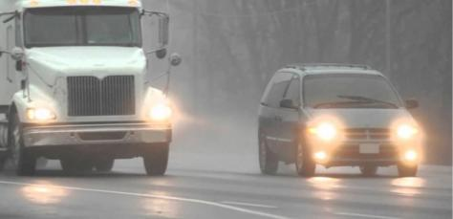
Do not overdrive your headlights. Stay within the limits of your vision. You may have to stop suddenly. If the fog is too dense, pull off the roadway and stop. Do not drive at 5-10 mph.
Use your turn signal long before you turn, and brake early when you approach a stop to warn other drivers.
Back to Menu

Slide 55
Driving in Rain
Illinois law requires you to turn on your headlights when operating your windshield wipers. When rain begins to fall lightly, water, dust, oil and leaves cause the roadway to become slippery.
Back to Menu

Slide 56
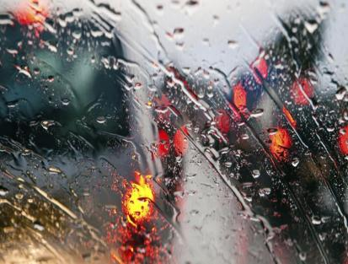
Take the following precautions when driving in rain:
Turn off the cruise control if in use and increase your following distance.
Take special care on curves and turns and while braking.
Back to Menu

Slide 57
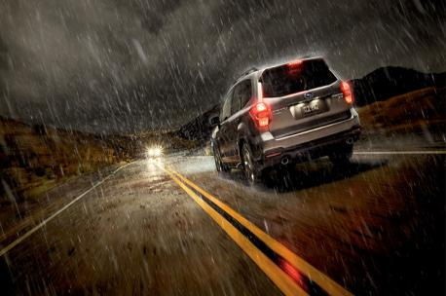
Avoid hydroplaning by slowing down. If you skid while hydroplaning, try to regain control of the vehicle.
Ease off both pedals and keep a firm grip on the wheel; steer where you want the car to go.
Back to Menu

Slide 58
Do not overdrive your headlights. Stay within the limits of your vision. You may have to stop suddenly. If the fog is too dense, pull off the roadway and stop. Do not drive at 5-10 mph.
Use your turn signal long before you turn, and brake early when you approach a stop to warn other drivers.
Back to Menu

Slide 59
WINTER DRIVING
When driving in slick conditions, “slow and steady” wins the race.
Back to Menu

Slide 60
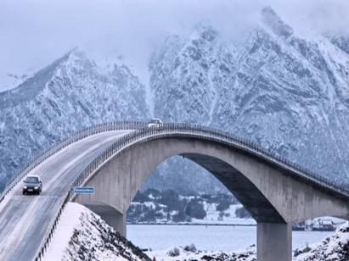
Drive slower and increase your following distance. Roadway conditions may vary depending upon the sun, shade or roadway surface.
Gentle braking in slow, steady strokes helps you find out how much traction you have. Begin braking early when you come to an intersection or a stop.
Approach bridges, shaded spots, overpasses and turns slowly. They may remain icy after the rest of the roadway is clear and dry. Bridges freeze early because no soil is present to keep the road surface warm.
Back to Menu

Slide 61
NIGHT DRIVING
Headlights must be used from dusk to dawn.
Never overdrive your headlights. Always keep them clean and aimed properly.
Bright lights (high beams) must be dimmed 500 feet before meeting an oncoming vehicle or 300 feet before passing a vehicle.
Back to Menu

Slide 62
Handling Skids
Skidding occurs when tires lose traction. If you skid, ease off the gas pedal or brakes.
Steer into the direction of the skid--meaning, steer where you want the car to go--until you feel you have regained traction and then straighten your vehicle.
Back to Menu

Slide 63
Driving off the Pavement by Mistake
If your wheels drift off the pavement onto the shoulder, grip the wheel firmly, ease your foot off the gas pedal and brake gently. After checking for traffic behind you, gently steer back onto the pavement.
Do not jerk your wheel to correct your steering. This abrupt steering may cause you to drive into oncoming traffic.
Back to Menu

Slide 64
EQUIPMENT
Back to Menu

Slide 65
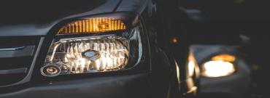
Equipment Failure: Blowouts and Brake Failure
Headlights — Vehicles must have two headlights and they must be on from sunset to sunrise and be used in times when rain, snow, fog or other conditions require the use of windshield wipers. They also should be used when objects 1,000 feet away cannot be seen. Bright lights must be dimmed 500 feet before meeting an oncoming vehicle or 300 feet before passing a vehicle.
Blowouts — A thumping sound may be a warning of a blowout. If this happens, ease your foot off the gas pedal and keep a firm grasp on the steering wheel. Do not brake suddenly. Pull safely off the roadway and check your tires.
Brake failure — If your brake pedal suddenly sinks to the floor, pump it to build pressure. If that does not work, use your emergency or parking brake. To slow down, shift your vehicle into a lower gear.
Required Equipment: Headlights
Back to Menu

Slide 66
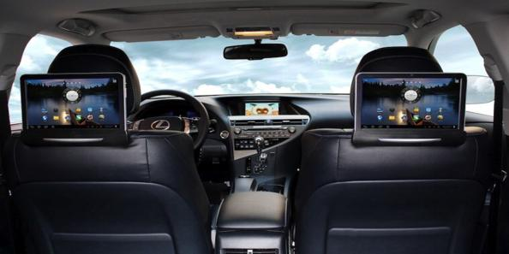
Restricted Equipment: TV/Video Monitors
Since a driver must be focused on the road at all times, televisions or video recording monitors that can be seen from the driver’s seat are prohibited while the vehicle is in motion.
Back to Menu

Slide 67
Thank you!
Thank you for completing the Online Written Exam Course. Idrivio will provide you with a solid background for success on the Written Exam.
To take the practice Written Exam
Click Here
support@idrivio.com
www. Idrivio.com

